Slide 1
Managing Your Engineering Career
Engineering Ethics

Slide 2
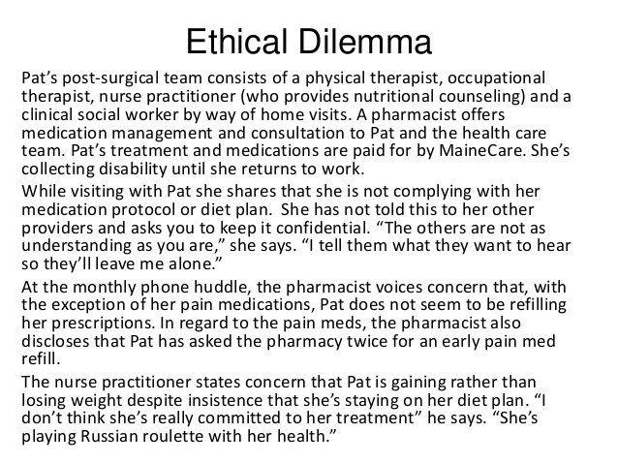

Slide 3
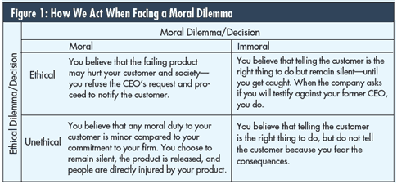

Slide 4
What is Ethics?
Ethics (dictionary) “the philosophy of morals or the standard of character set by any nation or race”
Morals (dictionary) “pertaining to action with reference to right and wrong”.
Ethics is about behavior, doing the right thing in the face of dilemma. Ethical people take the “right” and “good” path when they come to the ethical choice points.
Values are integral to attitude formation and to how we respond to people and situations.

Slide 5
Established behavioral standards and written codes of ethical conduct can help bolster virtuous values and promote ethical organizational behavior.
Behavioral standards usually incorporate specific guidelines for acting within specific functional workplace areas.
Most engineering professional societies have a code of ethics. As engineering community becomes more global, it is important to recognize ethics in a global sense.

Slide 6
Engineering Ethics:
“Study of moral values, issues and decisions as they relate to Engineering Practice”
Professional Societies and Codes of Ethics: “Provide a set of guidelines of how engineers should behave with respect to clients, the profession, the public, and the law”
“Engineers shall undertake assignments only when qualified by education or experience in the specific field involved”
“Engineers are morally responsible for harms they intentionally [knowing and deliberately], negligently [unknowingly, but failing to exercise due care] or recklessly [aware that harm is likely to result] cause”

Slide 7
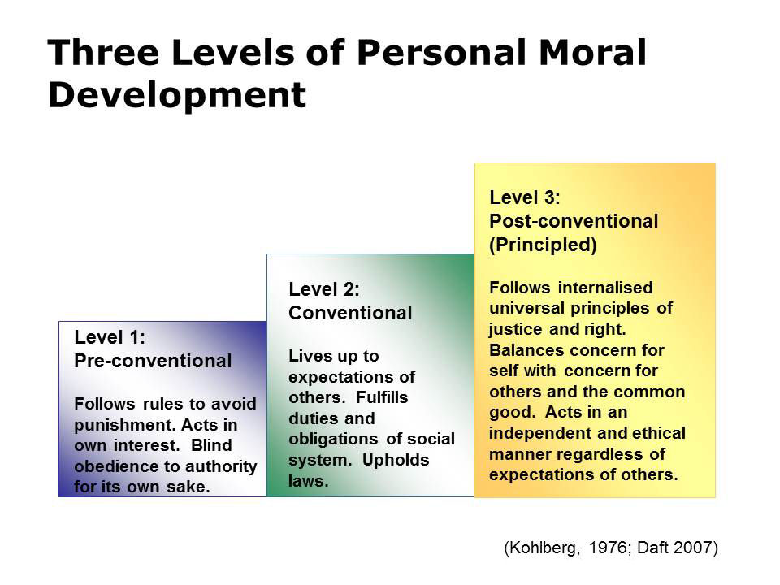

Slide 8
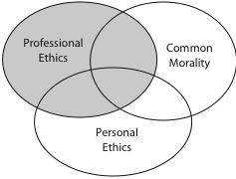

Set of standards adopted
by professionals
Moral ideals shared by most members of a culture or society
Set of one’s own ethical commitments
usually given in early home or religious
training

Slide 9
Professional Societies and Codes of Ethics
Provide a common agreed-upon standard for professional conduct
Do not provide new ethical principles but incorporate a lot of what is found in common morality
Various Engineering Societies have their own code of ethics
“Provide a set of guidelines of how engineers should behave with respect to clients, the profession, the public, and the law”

Slide 10
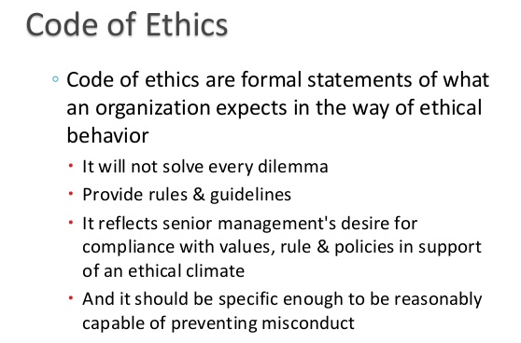

Slide 11
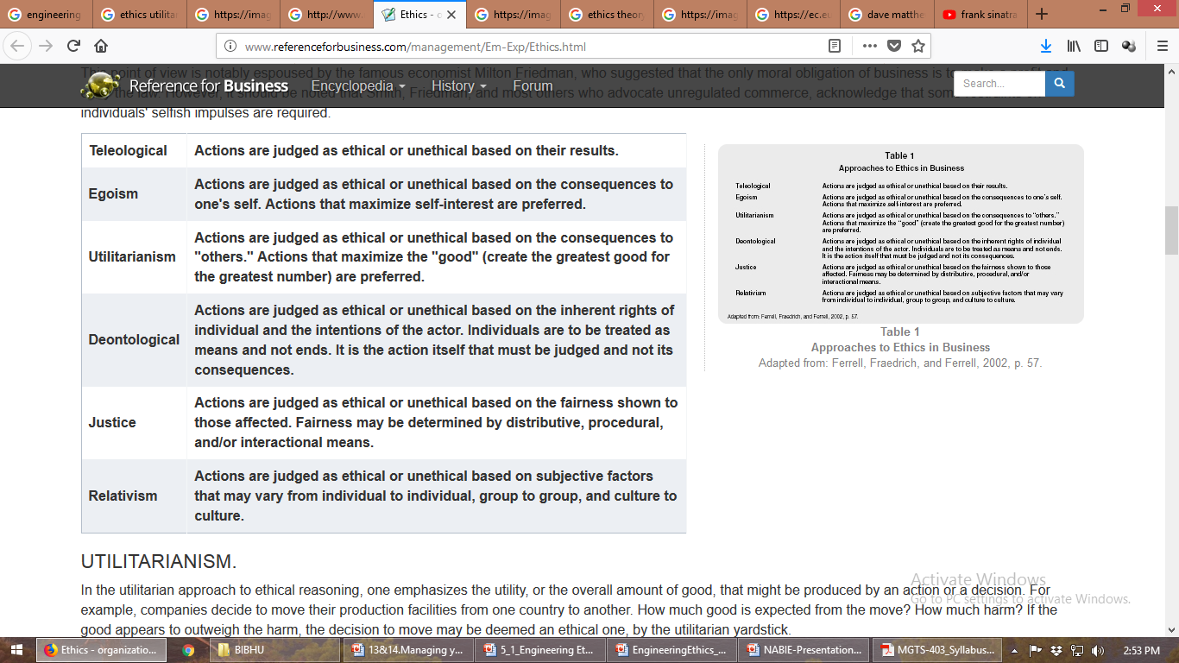
Approaches to Ethical Decision Making

Slide 12
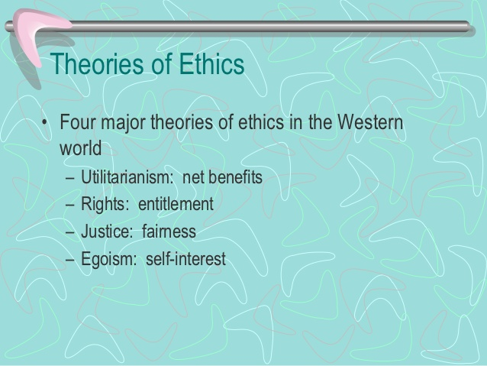
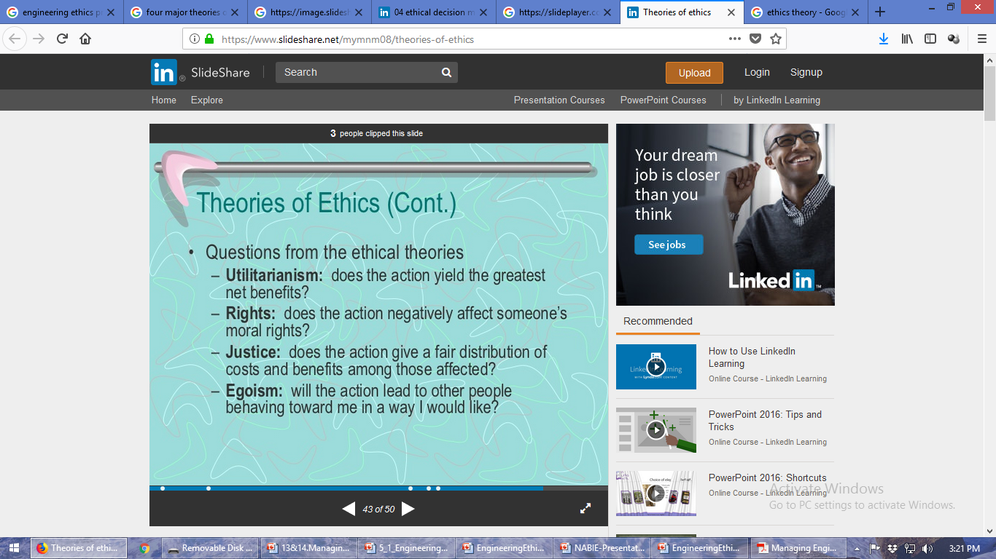
Four Major Theories of Ethics

Slide 13
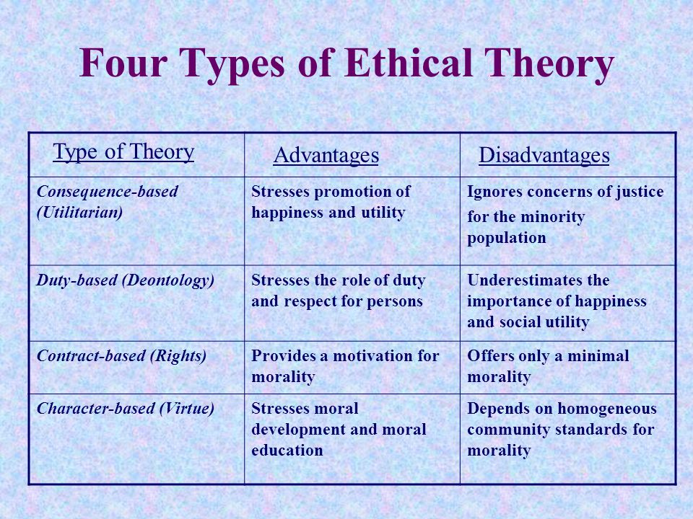

Slide 14
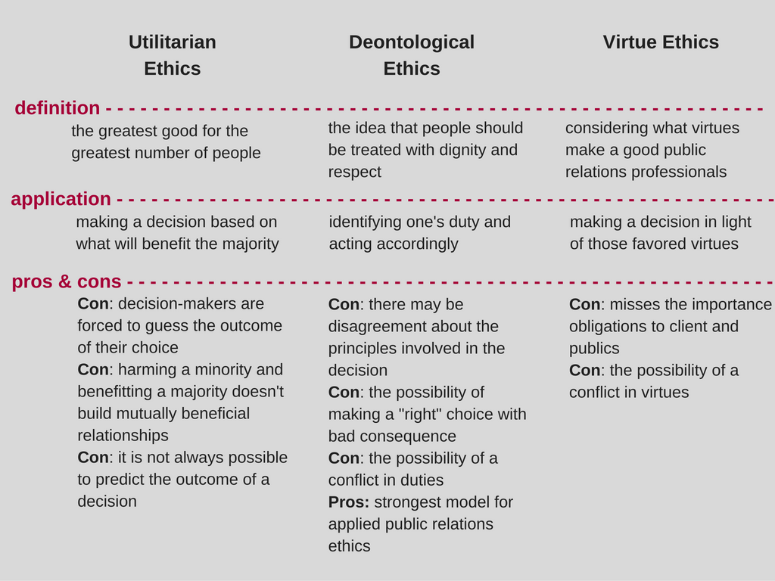
No single one of these views provides us with simple, reliable guide to resolving the ethical dilemmas. In the end, we must fall back on our personal set of values – individual, professional, societal, and human values.

Slide 15
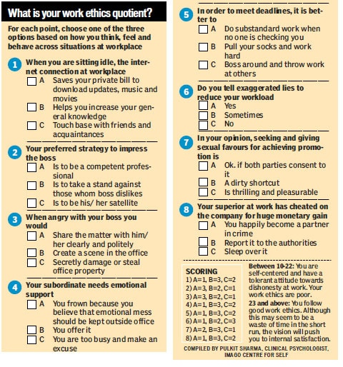

Slide 16
Ethical Problems in Industrial Practice
Environmental Problems
Conflict of Interest
Gifts
Moonlighting
Inside Information
Post Employment Problems
Sexual Harassment

Slide 17
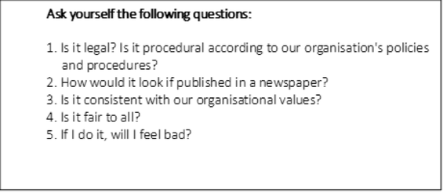

Slide 18
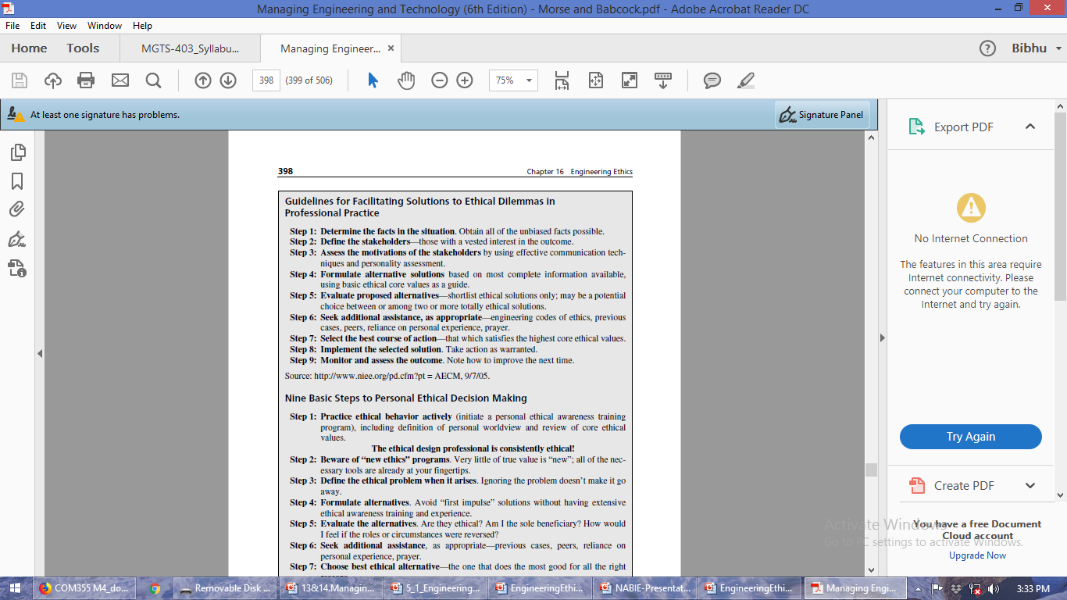

Slide 19
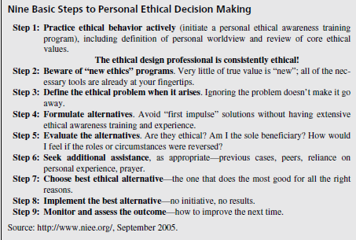

Slide 20
Whistle-blowing
Whistle-blowing is the act of telling the authorities or the public that the organization you are working for is doing something immoral or illegal.
It empowers employees to act on incidences of misconduct and help maintain a safe workplace, while protecting profits and reputation.
Responsible people blow the whistle when they believe more harm than good will occur if the whistle-blower stays silent. A virtuous whistle-blower acts in an ethical manner if she truly believes a responsibility exists to protect the public interest.

Slide 21
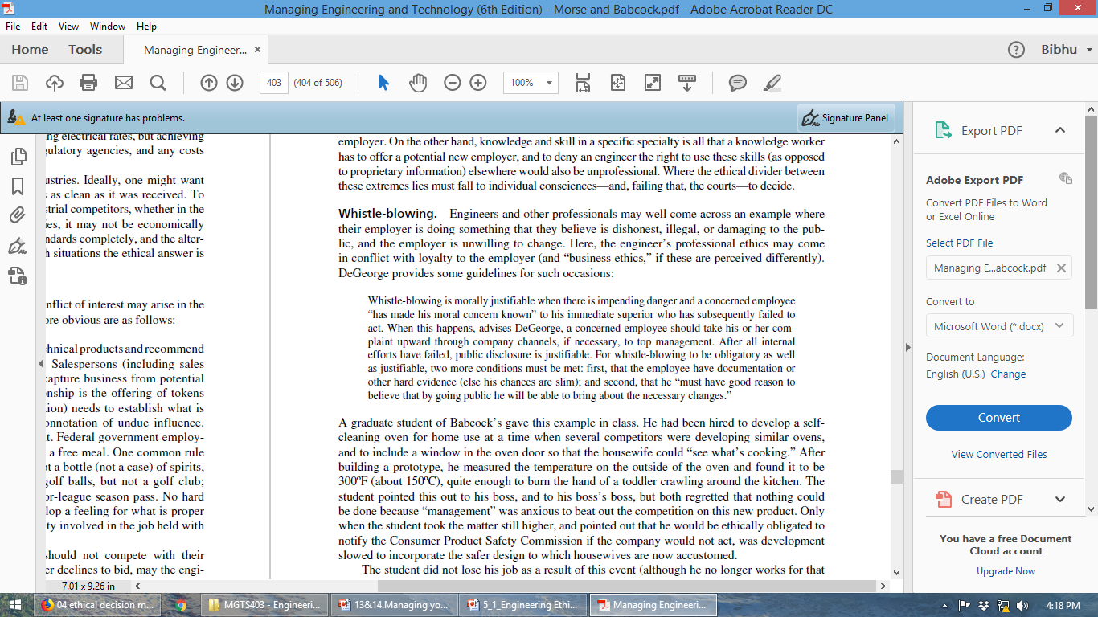

Slide 22
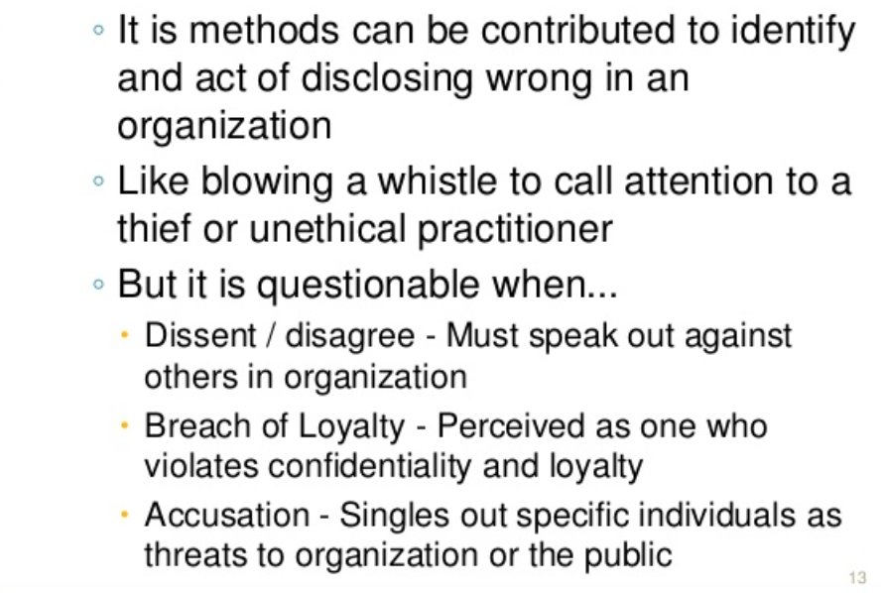

Slide 23
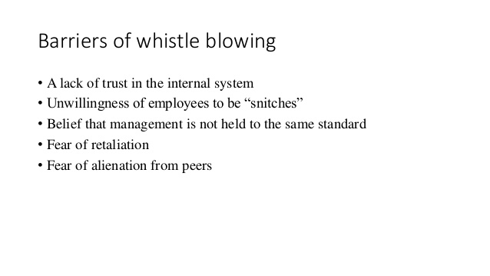
Barriers of Whistle-blowing

Slide 24
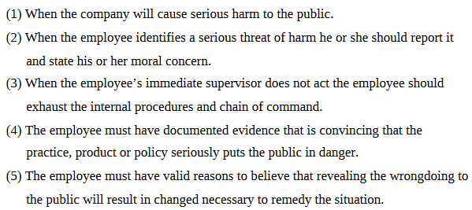
Whistle-blowing is considered ethical under following five conditions:
Whistle-blowing can be considered unethical if the employee is motivated by financial gain or media attention, or if they carry a vendetta against the company. In this case the legitimacy of their whistle-blowing must be questioned.

Slide 25
The morality of whistle-blowing might be viewed from the perspective that corporations have a moral obligation not to harm.
De George identifies five criteria when whistle-blowing is morally permitted.
(1) the firm's actions will do serious and considerable harm to others;
(2) the whistle-blowing act is justifiable once the employee reports it to her immediate supervisor and makes her moral concerns known;
(3) absent any action by the supervisor, the employee should take the matter all the way up to the board, if necessary;
(4) documented evidence must exist that would convince a reasonable and impartial observer that one's views of the situation is correct and that serious harm may occur; and
(5) the employee must reasonably believe that going public will create the necessary change to protect the public and is worth the risk to oneself.

Slide 26
Criteria for Blowing the Whistle In an Engineering Context
Permissive Whistle Blowing per De George: 1) The harm that will be done by the product [or company action] to the public is serious and considerable.
2) The engineer (or employee) has made their concerns known to their superiors.
3) The engineer (or employee) has received no satisfaction from their immediate supervisors and he has exhausted the channels available within the company, including going to the board of directors.

Slide 27
Mandatory Whistle Blowing per De George:
4) The engineer has documented evidence that would convince a reasonable, impartial observer that his/her concern for public safety is correct and the company product or action is likely to cause serious and considerable public harm.
5) There is strong evidence that making the information public will in fact prevent the threatened serious harm.

Slide 28
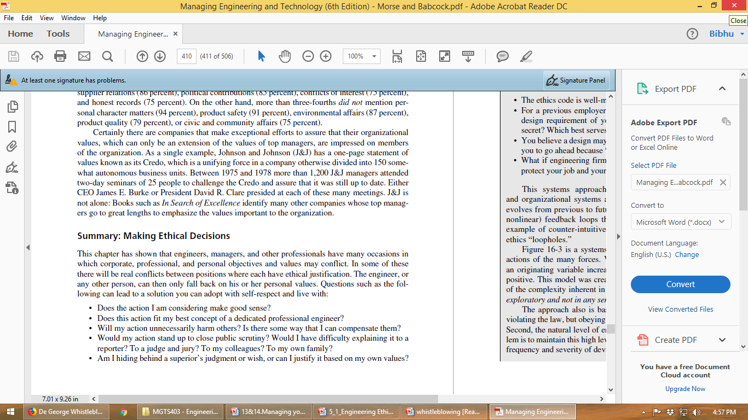
The following questions can lead to a solution you can adopt with self-respect and live with:

Slide 29
